Slide 1
Indiana Belgian Breeders
Stallion Sweepstakes
“Entered Stallion Services”
2020 Stallion Auction / 2021 Weanling Class

Slide 2

We are still accepting entries!!!
List will be updated as more forms are received!!
2020 Stallion Breeding Contract
Stallion Listings and Updates: www.inbelgiandrafthorse.org
Email all promotional pictures/fliers to: krissy14vu@hotmail.com
Return copy of all paperwork to:
Indiana Belgian Breeders Stallion Sweepstakes
Krissy Freitag
5912 E 1000 N
La Porte, IN 46350

Slide 3

SUBILBLE ELMO
S73148
1
Current Stud Fee:
$400
Owner: Adam Thomas
Phone: 219-229-8655
On Farm Only: LaPorte, IN
Mare Care: Wet $ 10 Dry $6
Sire: CJ Mitch
Dam: Stoney Lake Elma
DOB:05/2/17

Slide 4
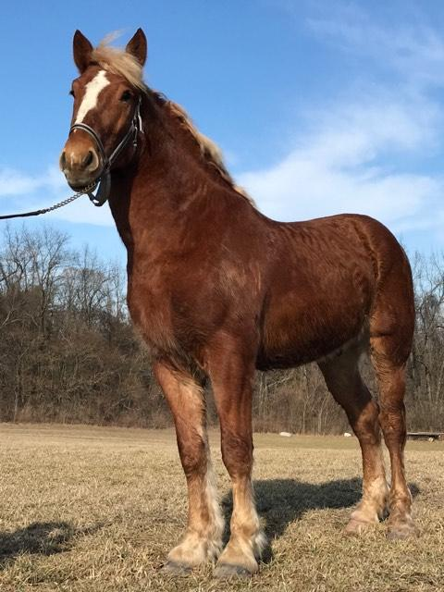
SUBILBLE ELMO
S73148
2
Current Stud Fee:
$400
Owner: Adam Thomas
Phone: 219-229-8655
On Farm Only: LaPorte, IN
Mare Care: Wet $ 10 Dry $6
Sire: CJ Mitch
Dam: Stoney Lake Elma
DOB:05/2/17

Slide 5

WILLOW CREEK BAJA
S71673
3
Current Stud Fee:
$700
Owner: DeWayne Beechy & Leland Lehman
Phone: 260-350-9829
Standing @ Crystal Springs
330-231-2776
Sire: Detweiler’s Prince Charming
Dam: LCH Mitch’s Isbella
DOB: 2/6/16

Slide 6
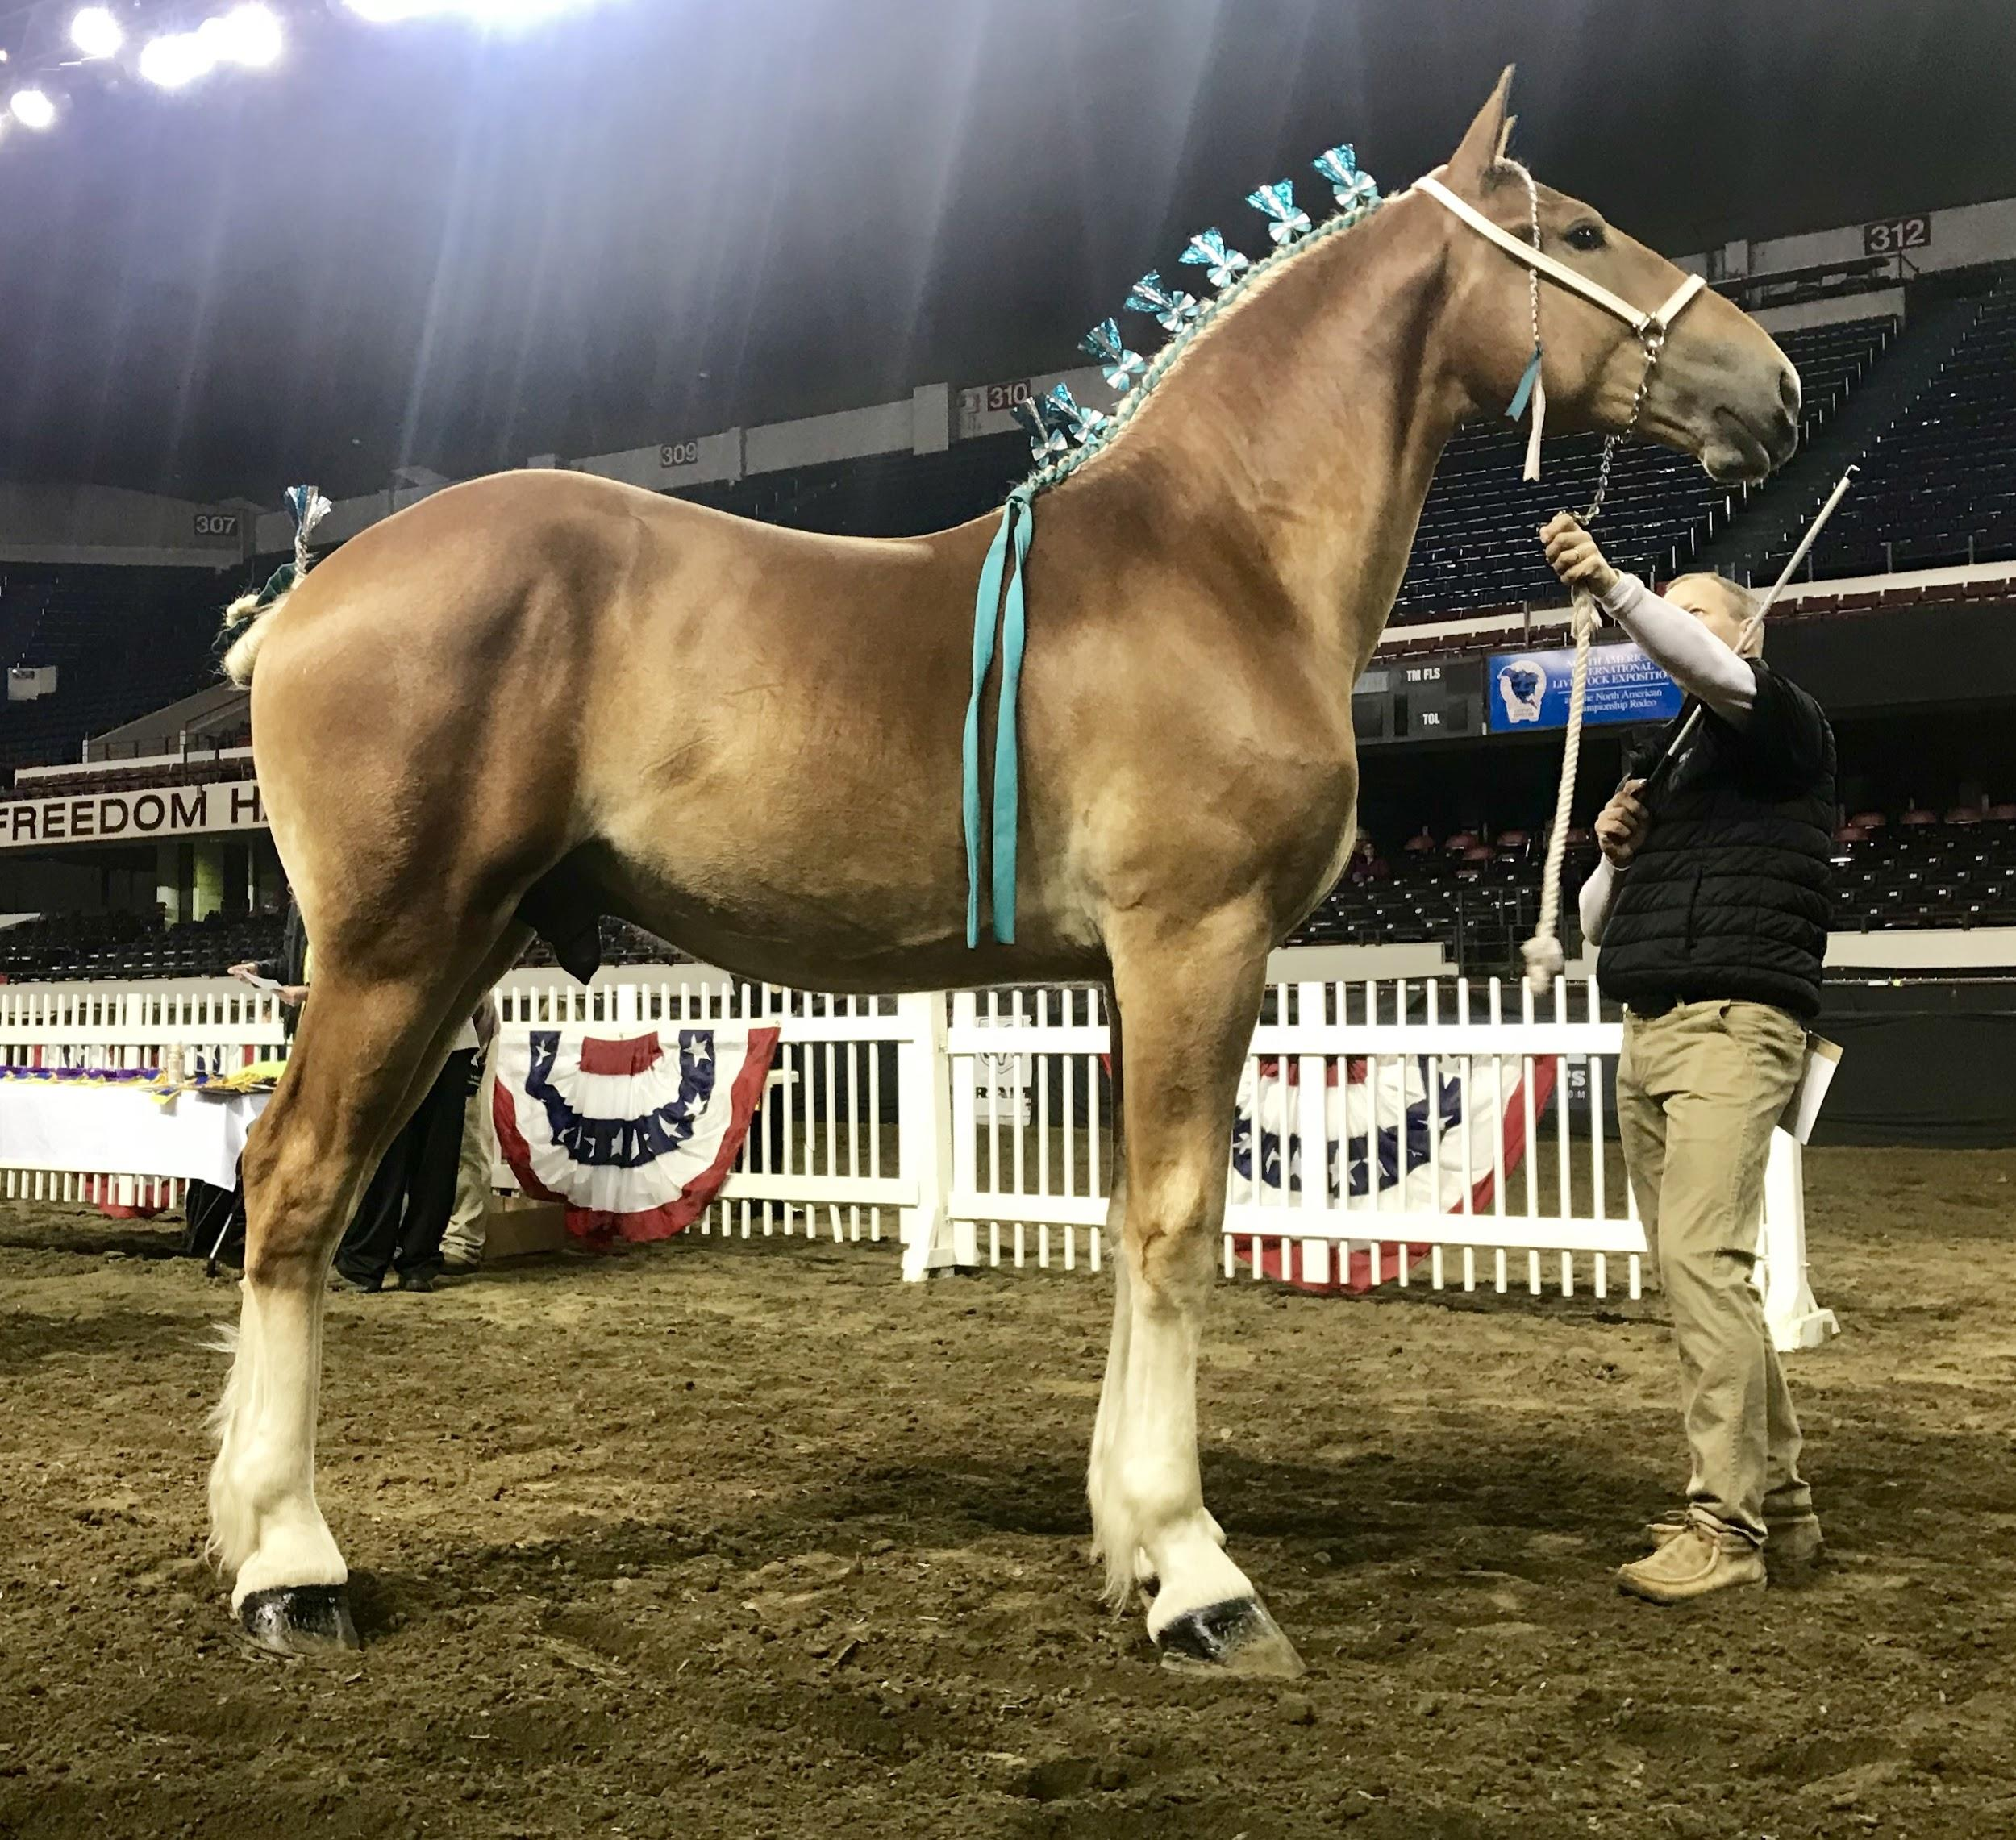
FREEWAY’S ROGER
S72334
4
Current Stud Fee:
$500
Owner(s): Derek Knepp &
Jacob Ray & Betty Jean Knepp
Phone:812-486-8530
Shipping or On Farm Breeding
Montgomery, IN
Mare Care:
Wet: $15 Dry: $10
Sire: RKD Asset
Dam:Sweetwater Melody
DOB: 05/17/17

Slide 7
FREEWAY’S ROGER
S72334
5
Current Stud Fee:
$500
Owner(s): Derek Knepp &
Jacob Ray & Betty Jean Knepp
Phone:812-486-8530
Shipping or On Farm Breeding
Montgomery, IN
Mare Care:
Wet: $15 Dry: $10
Sire: RKD Asset
Dam:Sweetwater Melody
DOB: 05/17/17

Slide 8

OAK TREE’S MAURIC
S71864
6
Current Stud Fee:
$700
Owner: Royal Equine Acres, LLC
Phone: Freeman 260-593-0284
Shipping or On Farm Breeding
Royal Equine Acres
260-593-0289
Mare Care:
Wet: $15 Dry: $10
Shipping: $100
Sire: AgRestore Dylan
Dam: AgRestore's JW Miss Jody
DOB: 3/26/16

Slide 9

Orndorff’s Captain Encore
S67446
7
Current Stud Fee:
$650
Owner(s): Jesse Wittmer
Phone:260-410-7571
Shipping or On Farm Breeding
Produce Acres New Haven, IN
260-615-4242
Mare Care:
Wet: $12 Dry: $10
Shipping: $75
Sire: Orndorff’s U.C. Encore
Dam: Orndorff’s Captain Sabrina
DOB: 3/28/08

Slide 10
Orndorff’s Captain Encore
S67446
8
Current Stud Fee:
$650
Owner(s): Jesse Wittmer
Phone:260-410-7571
Shipping or On Farm Breeding
Produce Acres New Haven, IN
260-615-4242
Mare Care:
Wet: $12 Dry: $10
Shipping: $75
Sire: Orndorff’s U.C. Encore
Dam: Orndorff’s Captain Sabrina
DOB: 3/28/08

Slide 11

ROYAL E PIERRE
S71992
9
Current Stud Fee:
$600
Owner: Royal Equine Acres, LLC
Phone: Freeman 260-593-0284
Shipping or On Farm Breeding
Royal Equine Acres
260-593-0289
Mare Care:
Wet: $15 Dry: $10
Shipping: $100
Sire: Shaketa Hills Jay
Dam: Mill Acres Pearl
DOB: 2/7/17

Slide 12
AgRestore’s JW Duplex
S67537
10
Current Stud Fee:
$600
Owner(s): Jonas & Jacob Wittmer
Phone: Jonas 260-740-1854 Jacob 260-740-1853
Shipping or On Farm Breeding
AgRestore Farms
Woodburn, IN
Mare Care:
Wet: $10 Dry: $10
Sire: Annie’s Legacy Chief
Dam: PF Dixie’s Delight
DOB: 2/22/17
Picture Coming Soon

Slide 13

SHAKETA HILLS JAY
S65816
11
Current Stud Fee:
$650
Owner: Scott &/or Theresa Zube
Phone:920-627-061
Shipping or On Farm Breeding
Royal Equine Acres
260-593-0289
Mare Care:
Wet: $15 Dry: $10
Shipping: $100
Sire: JayJay Loyalea Man
Dam:L&M Mike’s Francis
DOB: 4/16/07

Slide 14
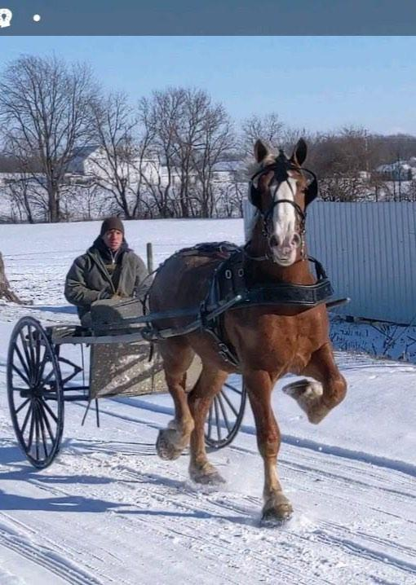
Jardine’s High Noon
S74610
12
Current Stud Fee:
$400
Owner(s): Arlin Hershberger
Phone: 574-304-7428
On Farm Breeding Only
Middlebury, IN
Mare Care:
Wet: $10 Dry: $8
Sire: Detweiler’s Princes Diamond
Dam: Provost Marilyn
DOB: 1/19/18

Slide 15
Clear Creek Thorne
S71714
13
Current Stud Fee:
$700
Owner(s): Dean Woodbury
Phone: 765-993-3081
On Farm Breeding Only
Winchester, IN
Mare Care:
Wet: $10 Dry: $10
Sire: Whispering Wind’s Cactus
Dam: Clear Creek Jen
DOB: 3/16/16

Slide 16

AgRestore Dylan
S67537
14
Current Stud Fee:
$750
Owner(s): Jonas & Jacob Wittmer
Phone: Jonas 260-740-1854 Jacob 260-740-1853
Shipping or On Farm Breeding
AgRestore Farms
Woodburn, IN
Sire: Orndorff’s Eddie Debut
Dam:Orndorff’s Captain Glory
DOB: 03/20/10

Slide 17
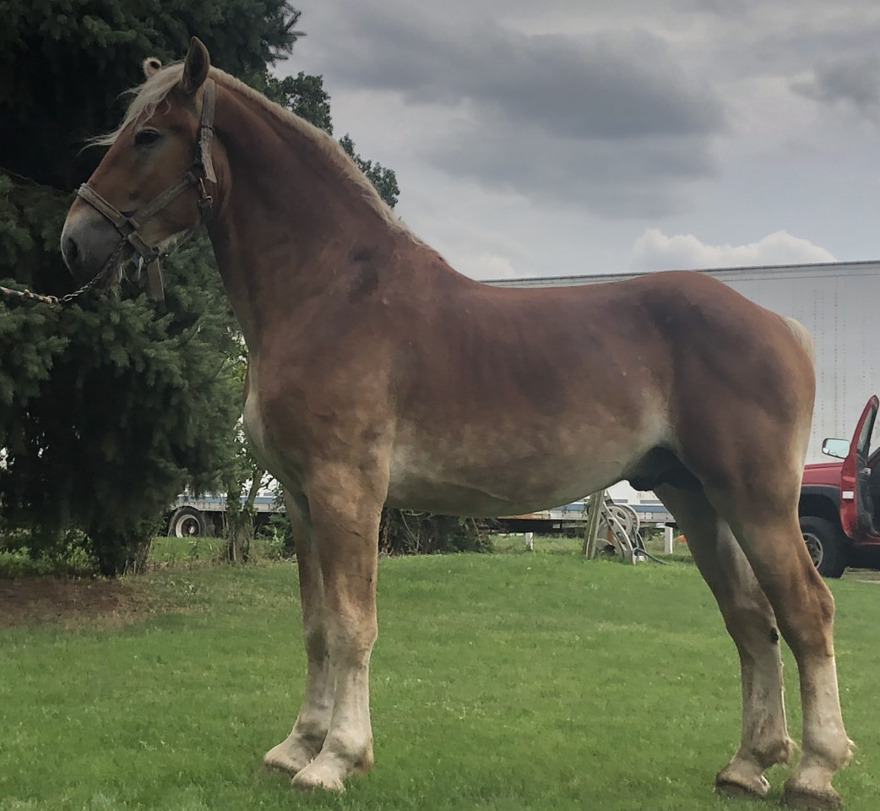
SUN SET ACRES ECLIPSE
S72714
15
Current Stud Fee:
$500
Owner(s): Lewis & Gail Biddle & Family
Phone: 814-571-5192
On Farm Breeding
Northview Farms
LaPorte, IN
Mare Care:
Wet: $12 Dry: $10
Sire: AgRestore Dylan
Dam: Sun Set Acres Joanna
DOB: 03/26/17

Slide 18
SUN SET ACRES ECLIPSE
S72714
16
Current Stud Fee:
$500
Owner(s): Lewis & Gail Biddle & Family
Phone: 814-571-5192
On Farm Breeding
Northview Farms
LaPorte, IN
Mare Care:
Wet: $12 Dry: $10
Sire: AgRestore Dylan
Dam: Sun Set Acres Joanna
DOB: 03/26/17

Slide 19
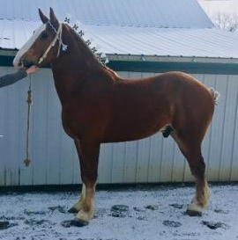
WB Hold Your Horse Harley
S73136
17
Current Stud Fee:
$500
Owner(s): Travis & Shari Westerfeld
Phone: 812-212-4135
Shipped ONLY
Westerfeld Belgians
Collection/Shipping Fee: $125
Sire: Charlie’s Dexter
Dam: Alpine Hill Barbie
DOB: 04/11/17

Slide 20
WB Hold Your Horse Harley
S73136
18
Current Stud Fee:
$500
Owner(s): Travis & Shari Westerfeld
Phone: 812-212-4135
Shipped ONLY
Westerfeld Belgians
Collection/Shipping Fee: $125
Sire: Charlie’s Dexter
Dam: Alpine Hill Barbie
DOB: 04/11/17

Slide 21
Farfield’s Dutchman
S73658
19
Current Stud Fee:
$
Owner(s): Adam Steinbrick
Phone:
Standing At: Jesse Wittmer
Phone: 260-410-7571
Mare Care:
Wet: $12 Dry: $10
Shipping: $75
Sire: PVF Ricky J
Dam: Farfield’s Haley
DOB: 03/23/18
Picture Coming Soon

Slide 22
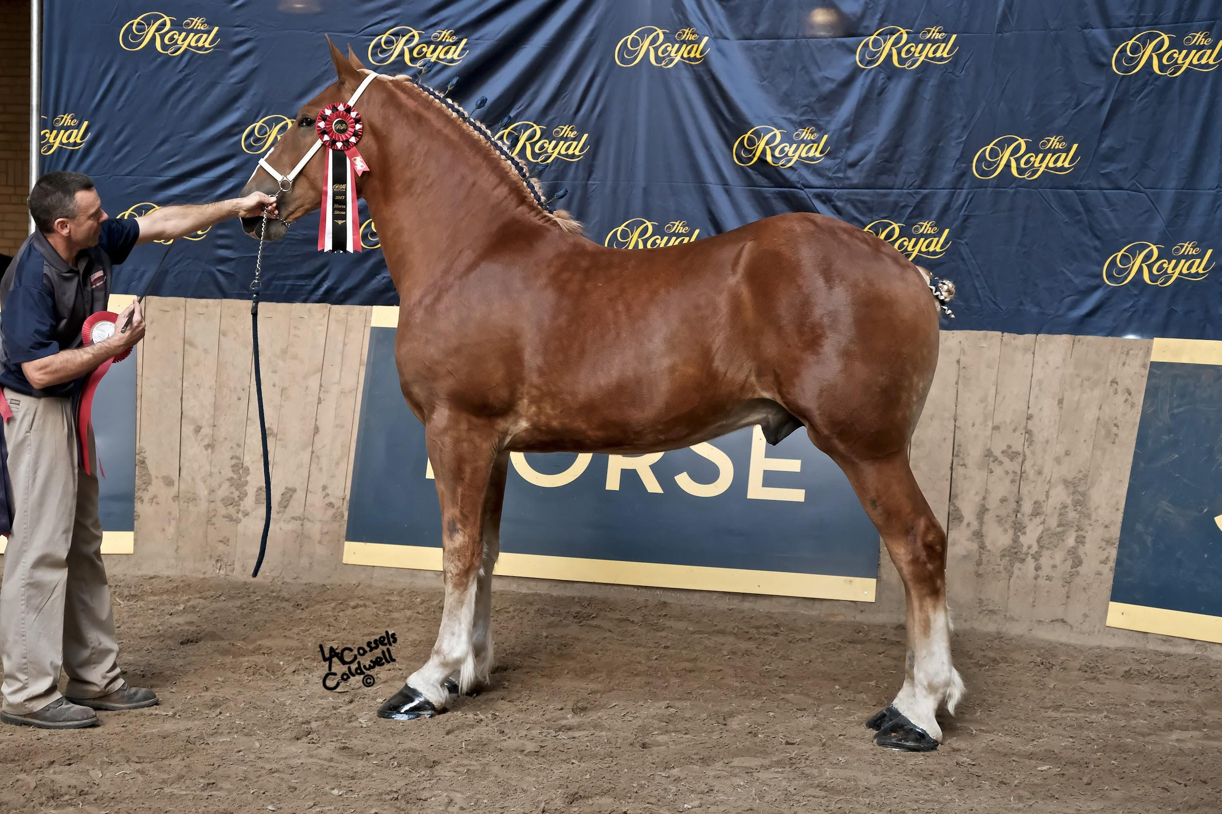
AgRestore’s Diamond’s Dream
S71974
20
Current Stud Fee:
$800
Owner(s): Nebergall Bros. &
Meadow Crest Stables
Phone: 217-841-6339
Standing @ Crystal Springs
330-231-2776
Sire: Detweiler's Prince’s Dream
Dam: AgRestore’s Carita
DOB: 02/23/16

Slide 23
AgRestore’s Diamond’s Dream
S71974
21
Current Stud Fee:
$800
Owner(s): Nebergall Bros. &
Meadow Crest Stables
Phone: 217-841-6339
Standing @ Crystal Springs
330-231-2776
Sire: Detweiler's Prince’s Dream
Dam: AgRestore’s Carita
DOB: 02/23/16

Slide 24

Triple M Farms Masterpiece
S72332
22
Current Stud Fee:
$600
Owner: Merlin M. Miller
Phone: 260-593-0476
Shipping or On Farm Breeding
Royal Equine Acres
260-593-0289
Sire: Whispering Winds Cactus
Dam: B.Y. Acres Lucy
DOB: 4/28/17

Slide 25

Annie’s Legacy Chief
S68559
23
Current Stud Fee:
$650
Owner(s): Jesse Wittmer
Phone:260-410-7571
Shipping or On Farm Breeding
Produce Acres New Haven, IN
260-615-4242
Mare Care:
Wet: $12 Dry: $10
Shipping: $75
Sire: Cowboy Chief
Dam: AgRestore’s JW Miss Ranea
DOB: 01/06/12

Slide 26
Annie’s Legacy Chief
S68559
24
Current Stud Fee:
$650
Owner(s): Jesse Wittmer
Phone:260-410-7571
Shipping or On Farm Breeding
Produce Acres New Haven, IN
260-615-4242
Mare Care:
Wet: $12 Dry: $10
Shipping: $75
Sire: Cowboy Chief
Dam: AgRestore’s JW Miss Ranea
DOB: 01/06/12

